Slide 1
GATE ANALYSIS
By
Piyush Rai, M.Tech (IIT Kanpur)
Nirvikar Gautam, M.Tech (IIT Kharagpur)
Assistant Professor
Department of Mechanical Engineering
VEC Lakhanpur

Slide 2
Outline of Presentation
Gate overview
Preparation
Subject wise marks distribution
Negative marking system and accuracy
Career opportunities
Planning
Concluding remarks

Slide 3
GATE Overview
GATE- Graduate Aptitude Test in Engineering
Conducting Body- IISc’s and 7 IIT’s (Bombay, Delhi, Guwahati, Kanpur, Kharagpur, Madras and Roorke), on behalf of the National Coordination Board – GATE, Department of Higher Education, Ministry of Human Resources Development (MHRD), Government of India.
GATE score- Relative performance level of a candidate.

Slide 4
Cont’d
Financial assistance provided by MHRD and other government agencies.
Exam and results – First week of February and second week of March.
Score is valid for 3 years.

Slide 5
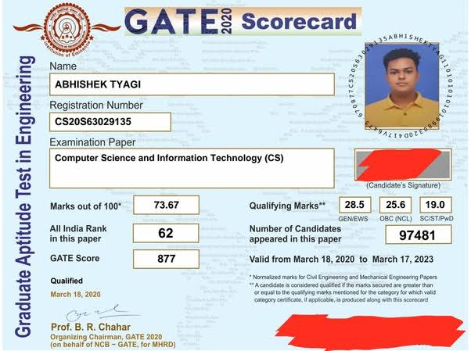

Slide 6
Preparation
Special Classes
Test Series
Various Coaching institutes
Previous year question papers

Slide 7
Subject Wise Weightage
Subject | Marks
Mathematics | 13-15
General Aptitude | 15
Subject Specific | 68-70
Total | 100

Slide 8
Pattern and Negative marking system
Two types of questions are asked in GATE - multiple choice questions (MCQs) and numerical answer type (NAT) questions.
As per the exam pattern of GATE 2018, the exam would be computer-based of three hours duration, comprising 65 questions.
For 1-mark MCQs, 1/3 mark will be deducted for every incorrect attempt.
In case of 2-mark MCQs, the candidate will be penalized 2/3 mark for wrong attempt.
For questions that aren’t attempted, zero marks will be awarded.
There is no negative marking for numerical answer type (NAT) questions.

Slide 9
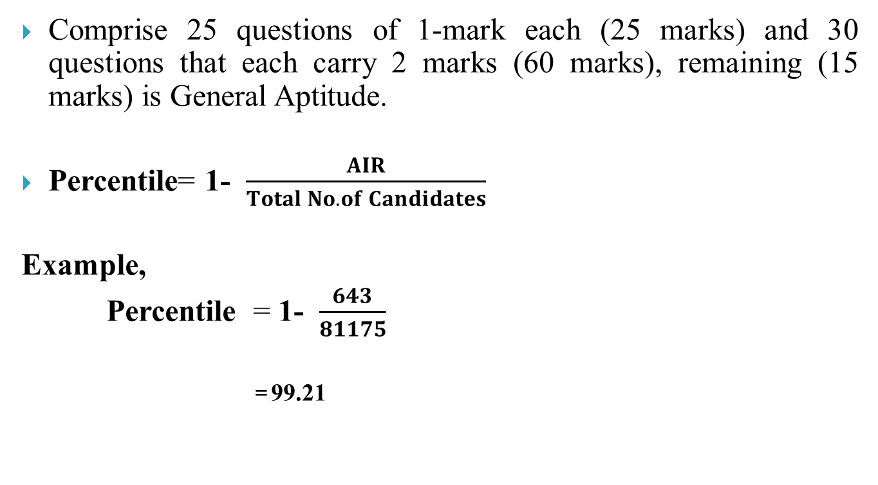
Cont’d
Comprise 25 questions of 1-mark each (25 marks) and 30 questions that each carry 2 marks (60 marks), remaining (15 marks) is General Aptitude.
Percentile= 1-$\frac{AIR}{Total No. of Candidates}$
Example,
Percentile = 1-$\frac{643}{81175}$
=99.21

Slide 10
Statistics
The number of candidates registered in the largest papers in last six year are:
Year | 2016 | 2017 | 2018 | 2019 | 2020
MN | 2753 | 2426 | 3049 | 3179 | 2426
CS | 108495 | 116754 | 134454 | 124984 | 116754
ME | 197789 | 2,17835 | 227735 | 198841 | 2,17835
EE | 125859 | 1,35426 | 140796 | 132294 | 1,35426
CE | 119873 | 1,47,012 | 177609 | 170999 | 1,47,012

Slide 11
Cont’d
Number of candidates appearing and qualifying in past year
S. No. | Statistics | 2015 | 2016 | 2017 | 2018 | 2019 | 2020
1. | Candidates appeared for the examination | 8,04,463 | 8,18,850 | 9,71,148 | 9,34,461 | 8,23,123 | 8,58,342
2. | Total number of qualified candidates based on qualification criteria | 1,21,060 | 1,60,643 | 1,29,149 | 1,29148 | 1,41,157 | 1,61,368
3. | Total number of qualified candidates based on qualification criteria (in percentage) | 15.05% | 16.53% | 16.40% | 16% | 17.2% | 18.80%

Slide 12
Cont’d
Qualifying Marks in GATE 2020
GATE Paper | Marks (UR) | Marks(OBC-NCL) | Marks(SC/ST/PWD)
Mining Engineering | 32.7 | 29.4 | 21.8
Computer Science & Information Technology | 28.5 | 25.6 | 19
Mechanical Engineering | 34 | 30.6 | 22.6
Electrical Engineering | 33.4 | 30 | 22.2
Civil Engineering | 32.9 | 29.6 | 21.9

Slide 13
List of (52+49) PSU companies recruit GATE qualified candidates for executive posts
Cont’d
S. No | PSU | Age Limit | Branch Allowed Based on previous years
1 | AAI | 27 | EE/EC
2 | BARC | 26 | ME,CE,EE,EC,IN,CS,CH
3 | NHAI | 30 | CE
4 | BEML | 27 | ME,EE,EC,MT
5 | BHEL | 27\29* | ME,EE
6 | NHPC | 30 | EE,CE,ME,GG
7 | BPCL | 28 | ME
8 | BSNL | 30 | CS,EC,EE,IN
9 | NTPC | 27 | EE,ME,EC,IN,CE
10 | ONGC | 30 | EE,ME,EC,IN,CE
11 | PGCIL | 28 | EE,EC,CE,CS
12 | DMRC | – | EE,EC
13 | DRDO | 28 | ME,EE,CH,EC,CS
17 | HAL | 28 | EE,EC,ME.CE
18 | HPCL | 25 | ME,CE,EE,EC,IN,CH
19 | IOCL | 26 | CH,CE,CS,EE,EC,IN,ME,MT,XE
And many more

Slide 14
Career Opportunities
PSU’s.
M-Tech from IISc’s, IIT’s, NIT’s and other reputed institutions across India.
M.S. from IIT’s, NIT’s and other reputed institutions across India.
Research and development centers as a scientist post.
MBA
Study Abroad

Slide 15
Concluding Remark
Test the Engineering basics in a smart way.
Task of mastering an entire course of Engineering (Around 30 subjects).
only around 16% of all appearing candidates qualify.
High percentiles (more than 95 percentile, in some cases) are required to get admission in M.Tech or to get shortlist for PSU’s.

Slide 16
Thank You

